Slide 1
Microsoft Teams
Step by Step
Here you can find step by step instructions how to work teams when uploading your kiddos work! Again, email is fine too but this is a great way to keep all your child's work stored in one place! Hopefully this helps, but please reach out if you need any help!

Slide 2
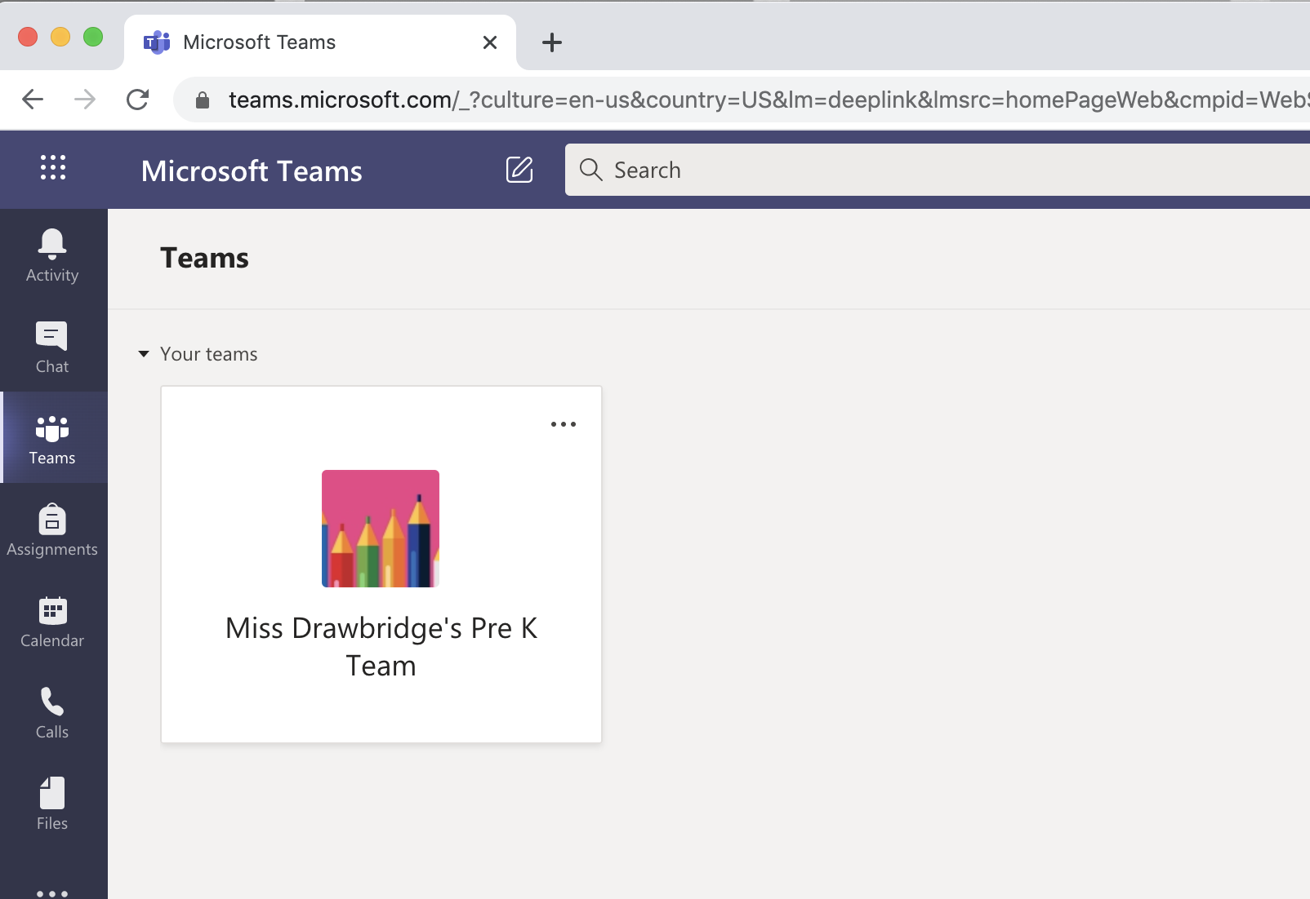
Step 1: Once Logged In

Slide 3
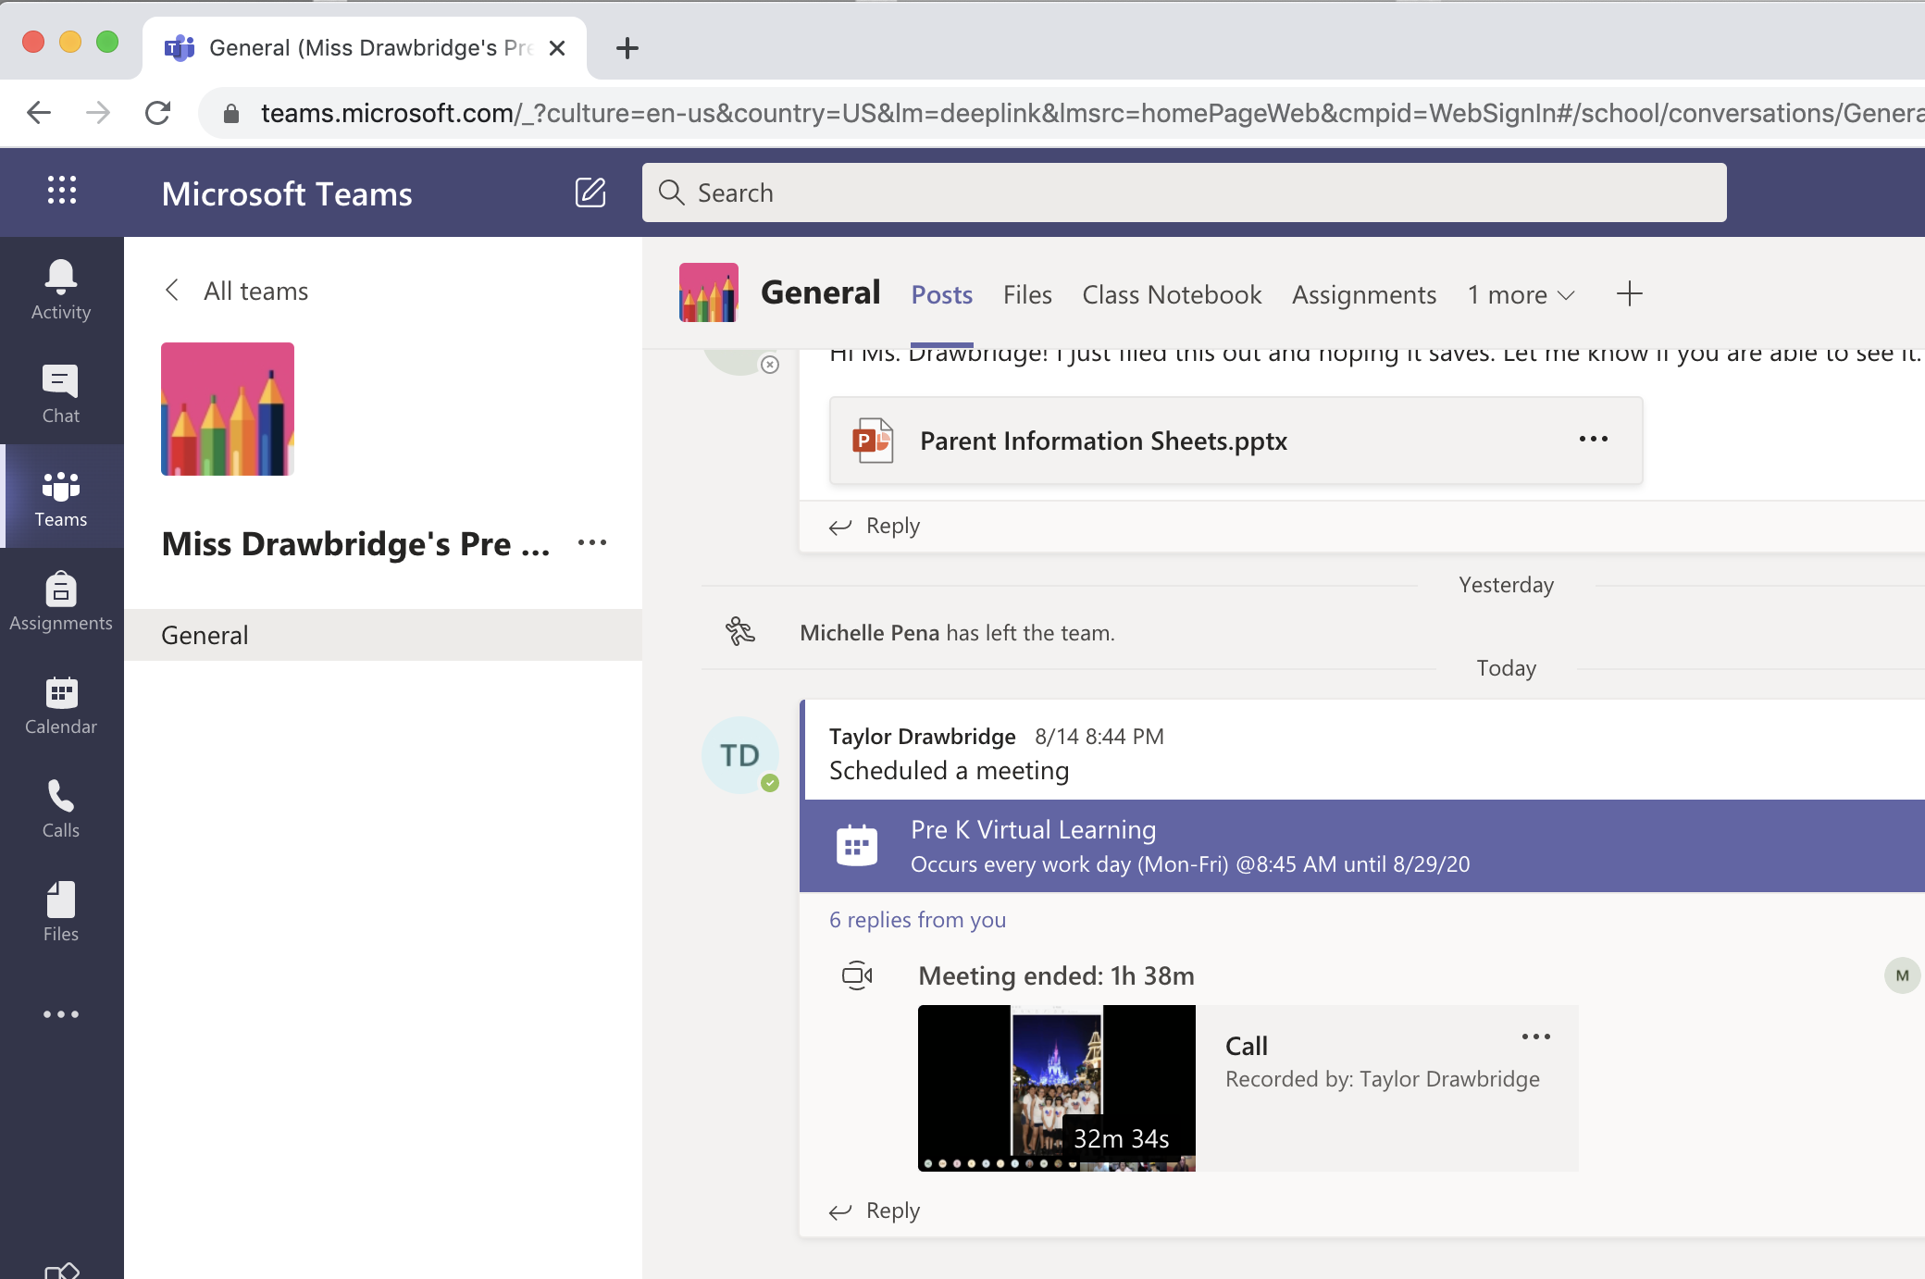
Step 2: Opening Page
After clicking our team, you should see our wall of posts

Slide 4
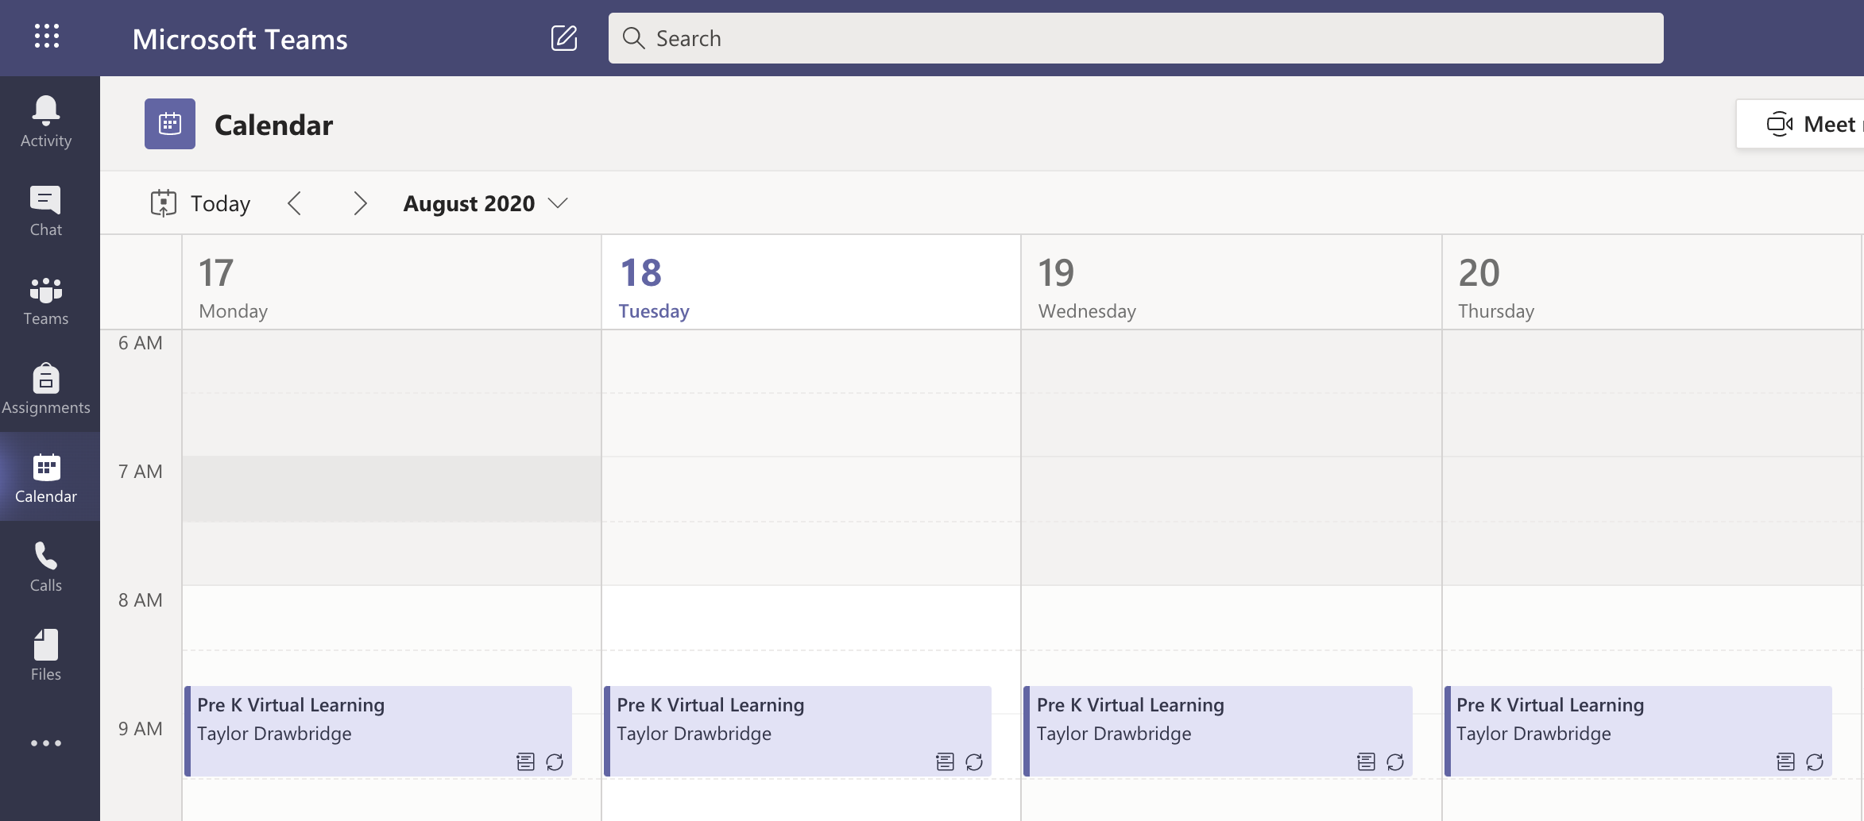
Step 3: Calendar
Under Calendar after using your child’s SCS email login, you will see all of our meetings set! Please utilize these to join our meetings each morning!

Slide 5
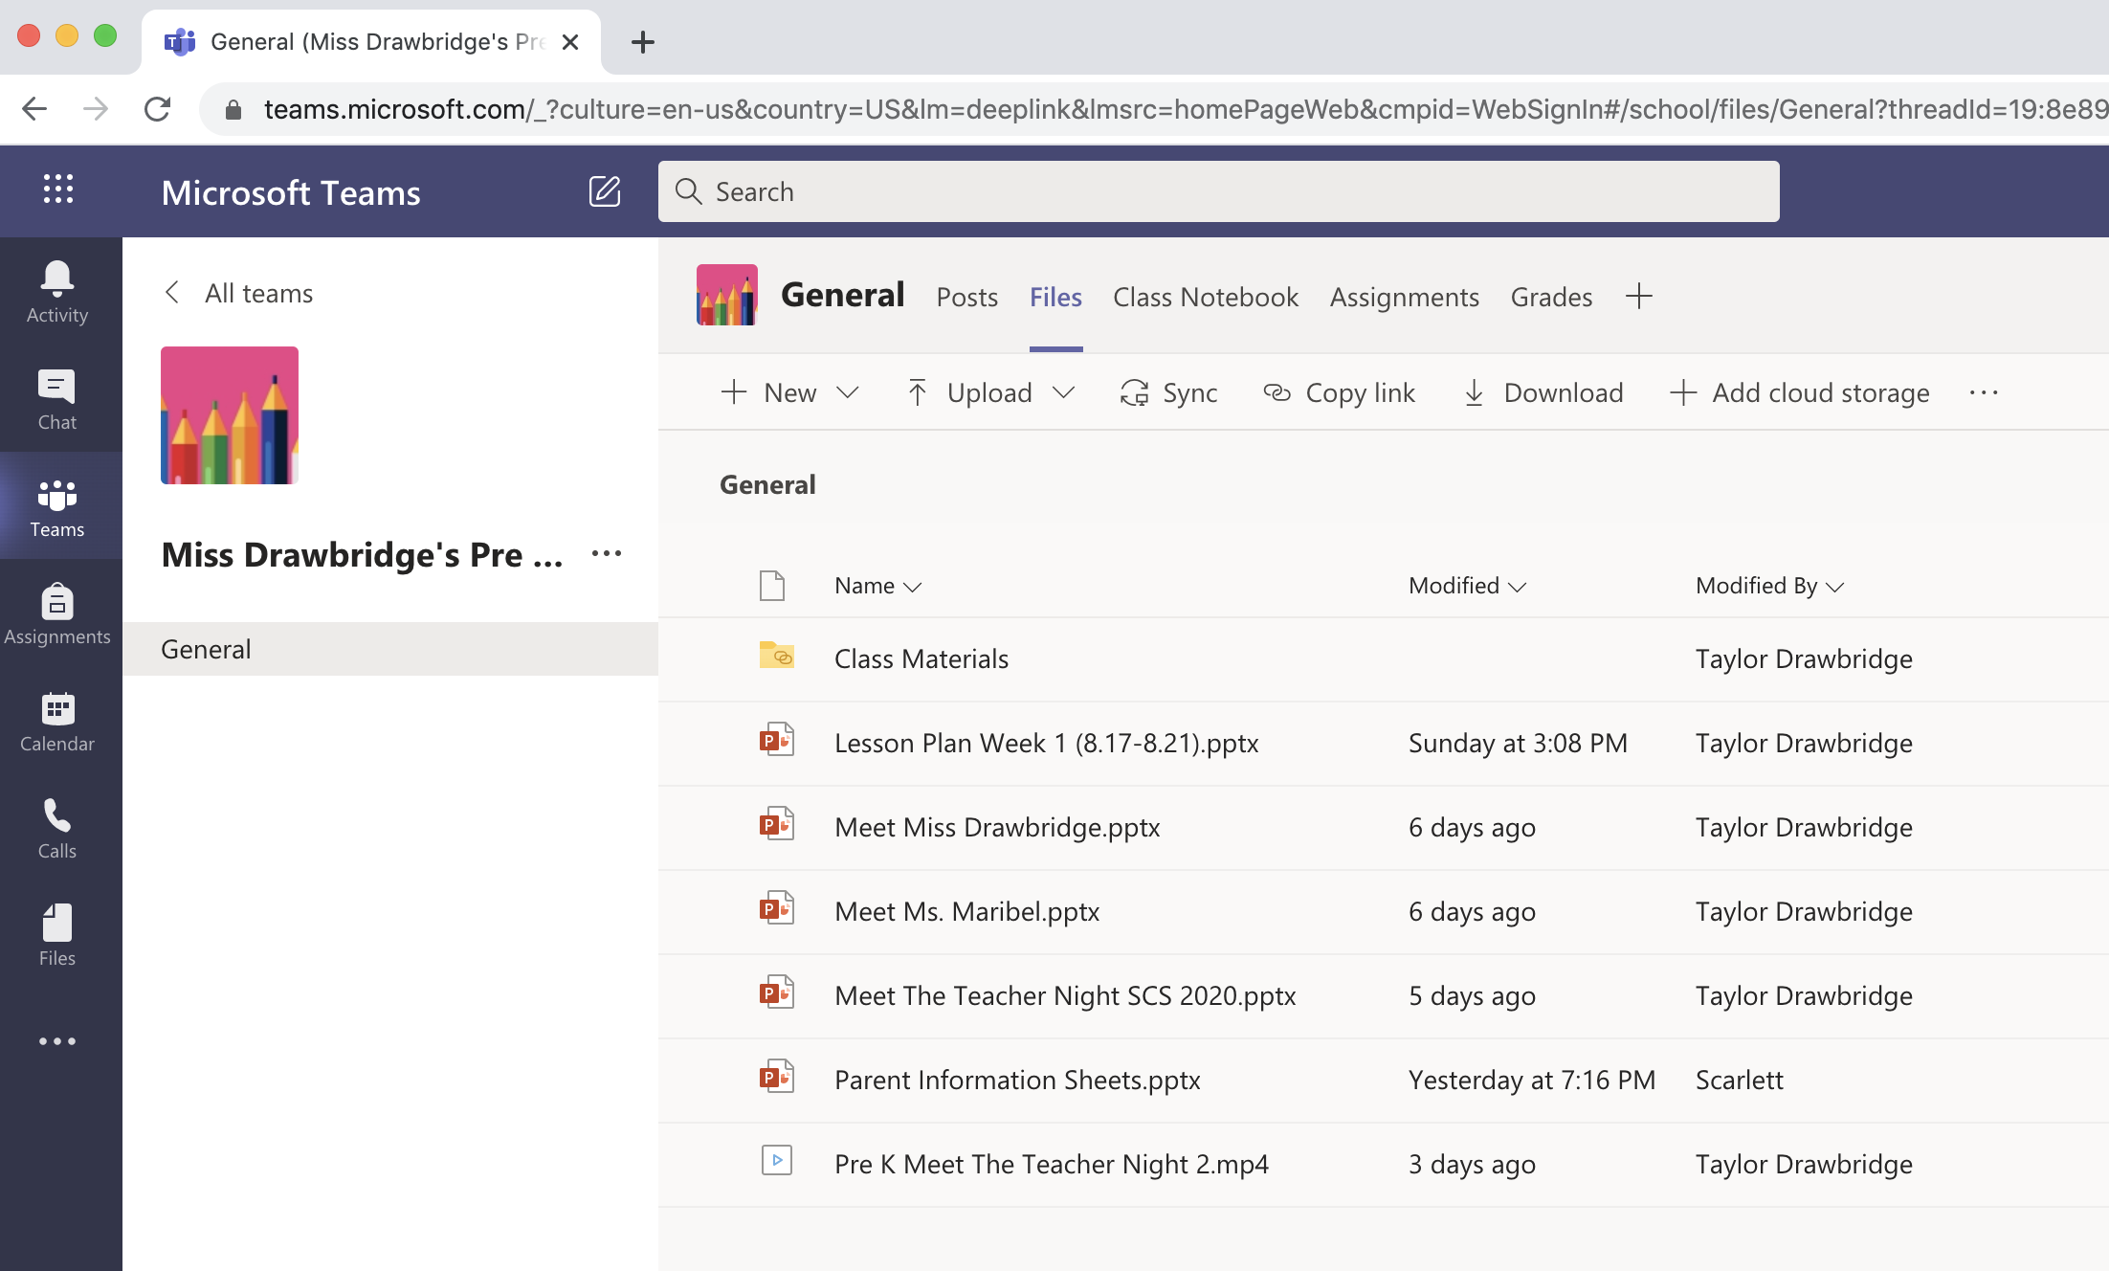
Step 4: Files
This is files! This is where I upload docs for you to refer to or to fill out! Here you will find the parent information sheet. Once you open it, make sure you DOWNLOAD first! Then email me the file. If you don’t have a printer available, you can email me the info in a standard format

Slide 6
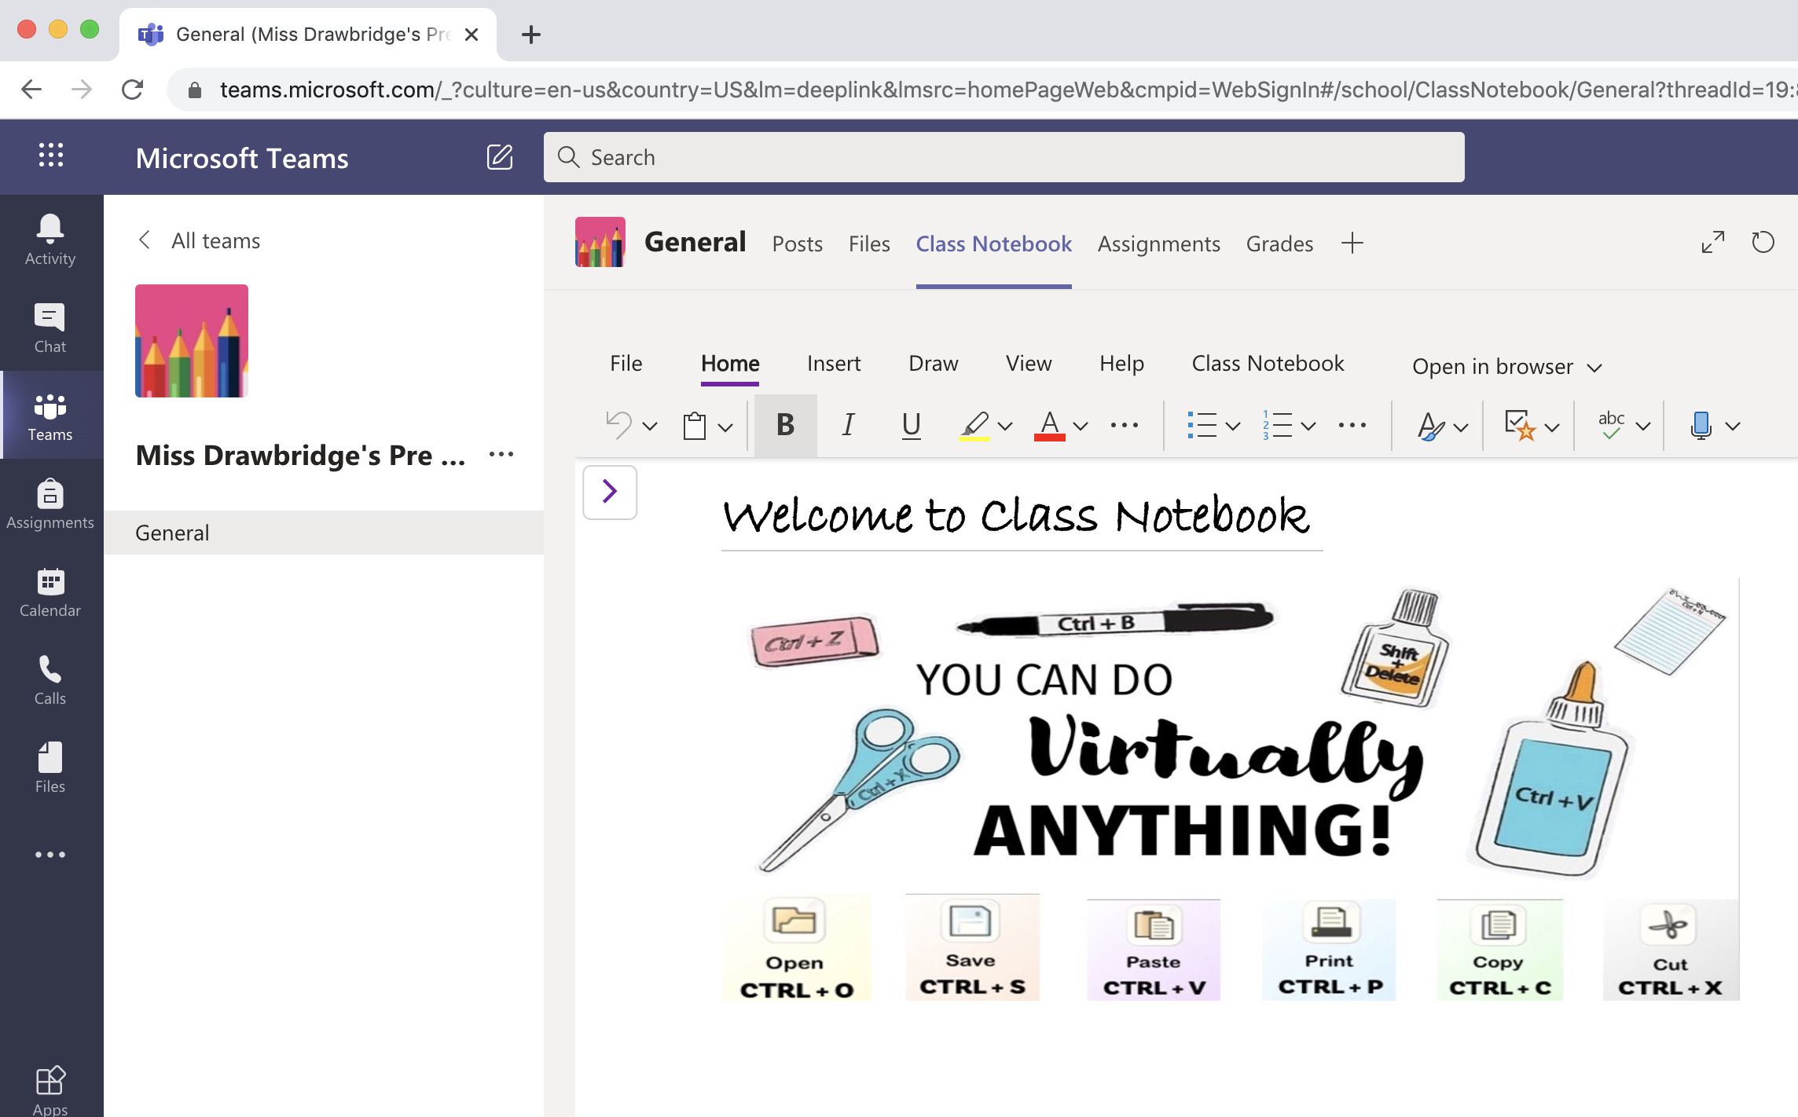
Step 5: Class Notebook

Slide 7
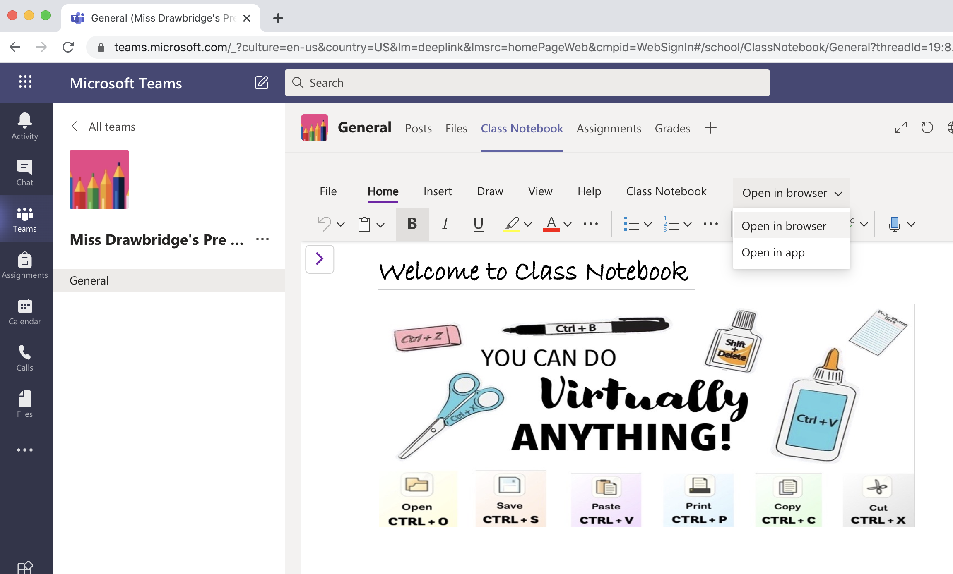
Step 6: Open in Browser

Slide 8
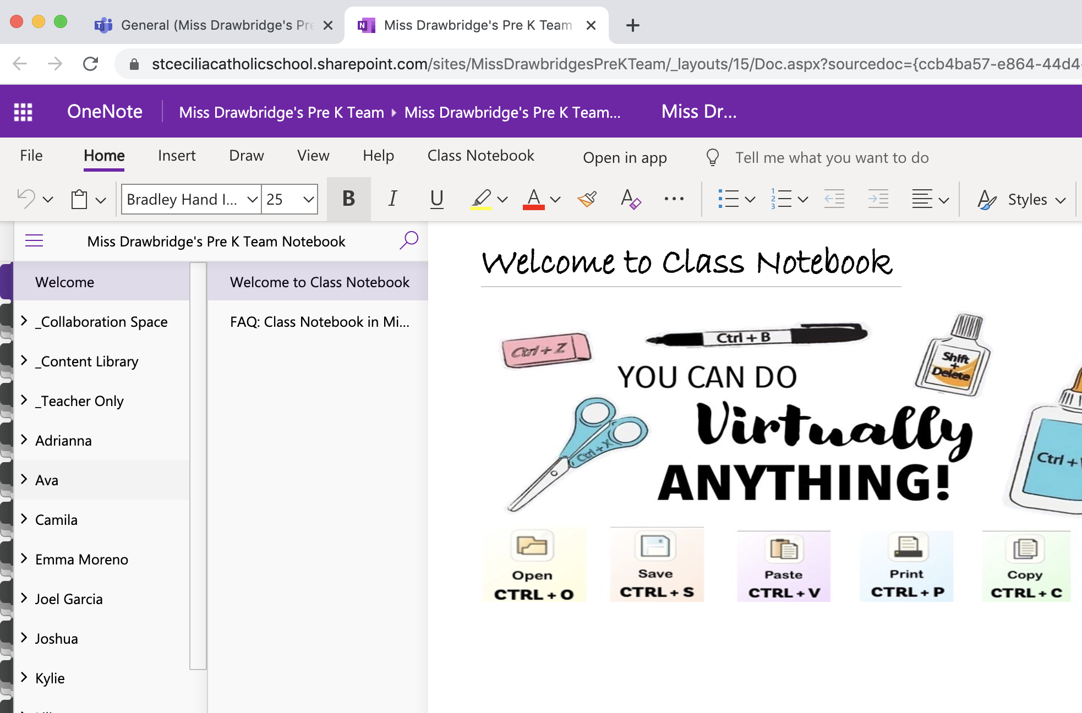
Step 7: You will only see your child’s journal

Slide 9
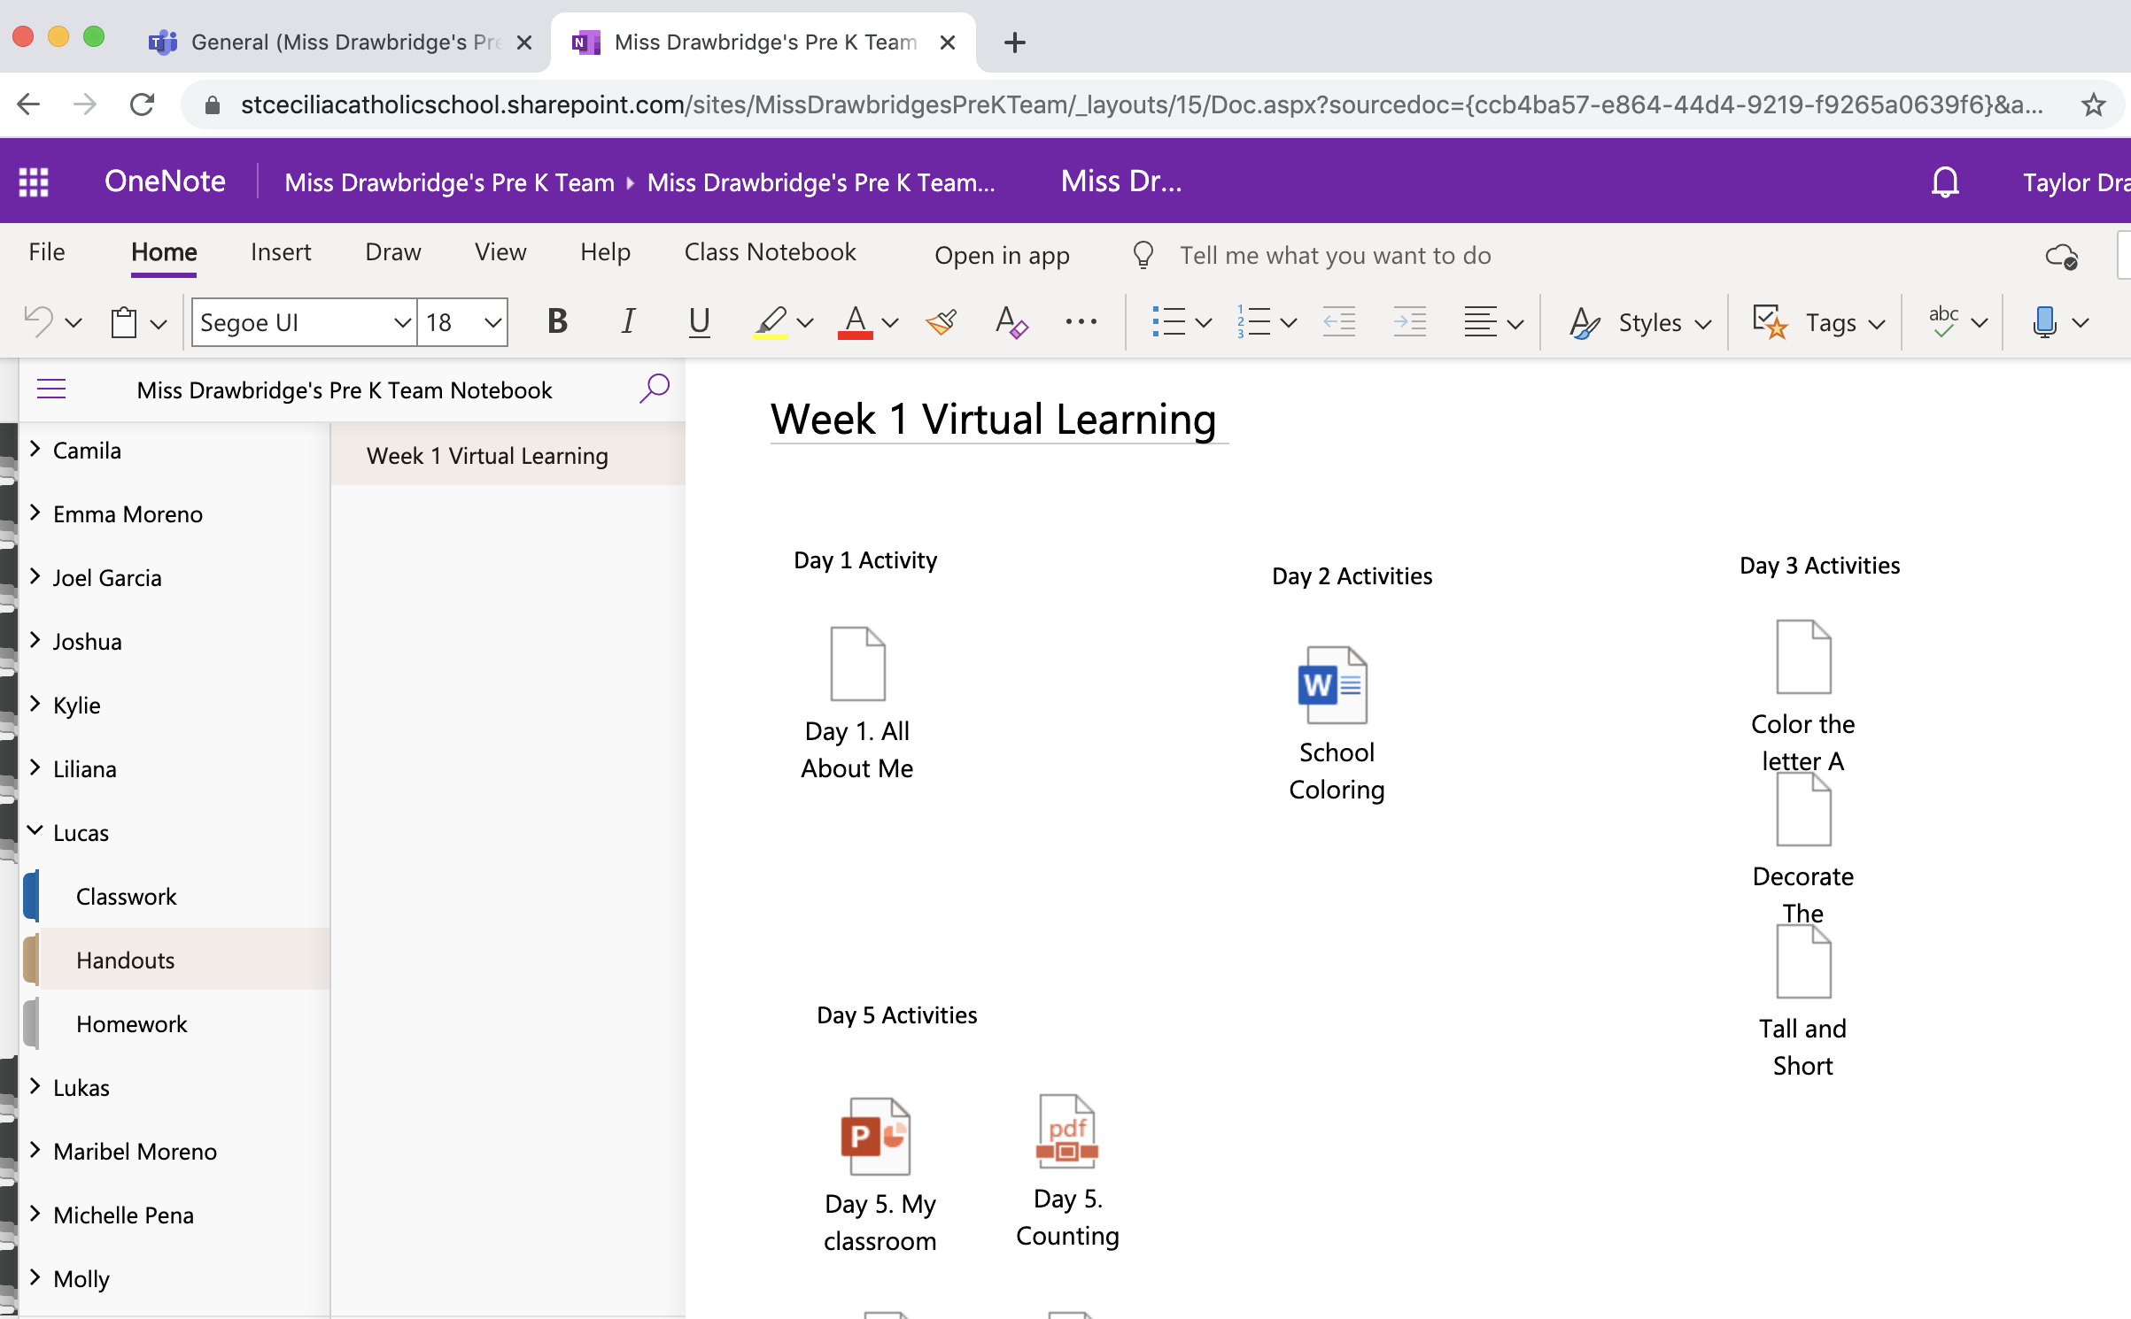
Step 8: Handouts Tab
Under Handouts, you will find more copies of your child’s activities for this week. They are the same as the ones sent in the lesson plans!

Slide 10
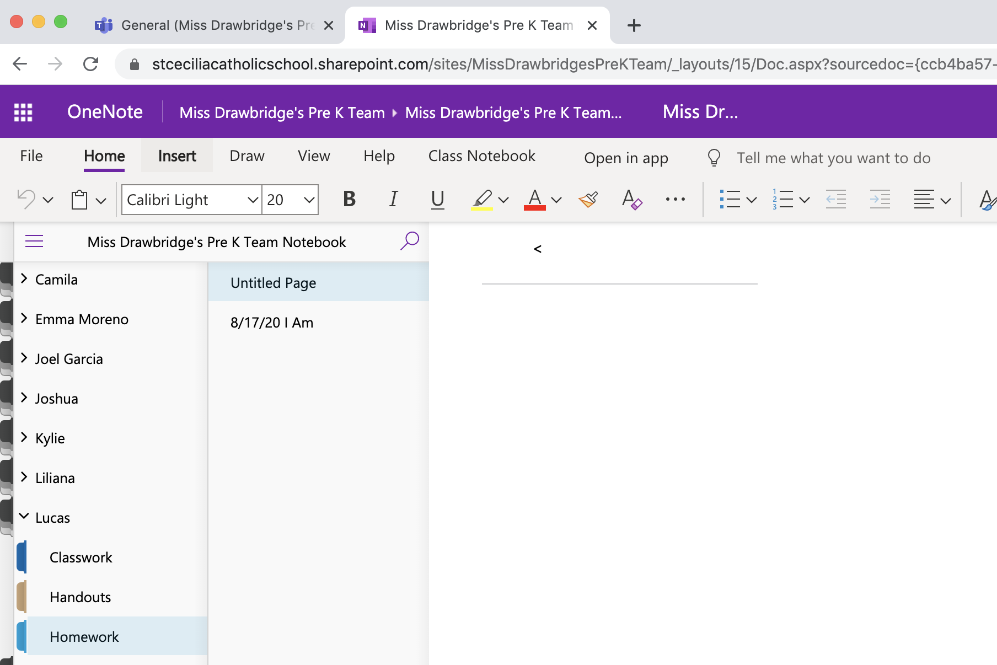
Step 9: Homework Tab
From here you can click the insert button next to home. You can make new pages like this example, or just add to the first page available!

